Slide 1
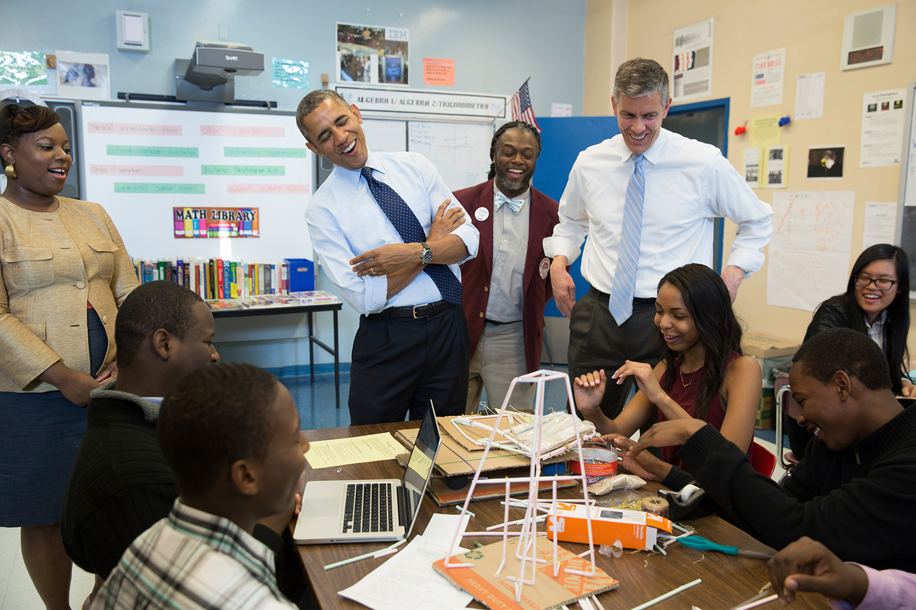
COURSES
Here you can browse some interesting courses that your high school provides and a course planner.

Slide 2
COLLEGE
Here you can find a lot of information on colleges, figure out which University is meant for you with the Supermatch, and take a look at all the available scholarships.

Slide 3
CAREER
Here you can figure out what career would be best for you with the career interest profiler or browse your options however you please. You can also check out the majors, skills, and colleges you need in order to succeed in your career.

Slide 4
MY PROFILE
Here you can check your student profile, test scores, GPA, class rank, and update your resume.

Slide 5
My Planner
Use this to create and complete goals for yourself (whether academic or social) and checkout what your counselor wants you to do in preparation for college.

